Slide 1
Ashfork-Bainbridge Steel Dam Structural Evaluation Project
DWP Engineering
Diwei Chen
Wen Cui
Paul Garrett
Notes:
This template can be used as a starter file for presenting training materials in a group setting.
Sections
Right-click on a slide to add sections. Sections can help to organize your slides or facilitate collaboration between multiple authors.
Notes
Use the Notes section for delivery notes or to provide additional details for the audience. View these notes in Presentation View during your presentation.
Keep in mind the font size (important for accessibility, visibility, videotaping, and online production)
Coordinated colors
Pay particular attention to the graphs, charts, and text boxes.
Consider that attendees will print in black and white or grayscale. Run a test print to make sure your colors work when printed in pure black and white and grayscale.
Graphics, tables, and graphs
Keep it simple: If possible, use consistent, non-distracting styles and colors.
Label all graphs and tables.

Slide 2
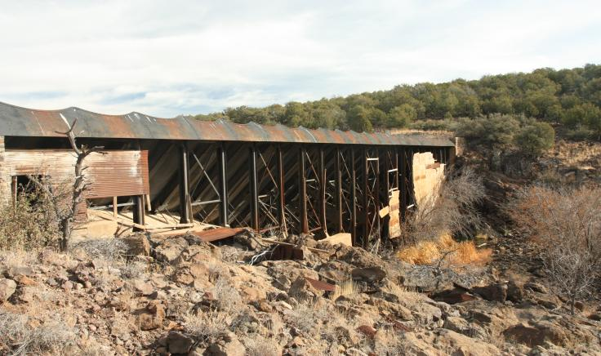
View of steel dam

Slide 3
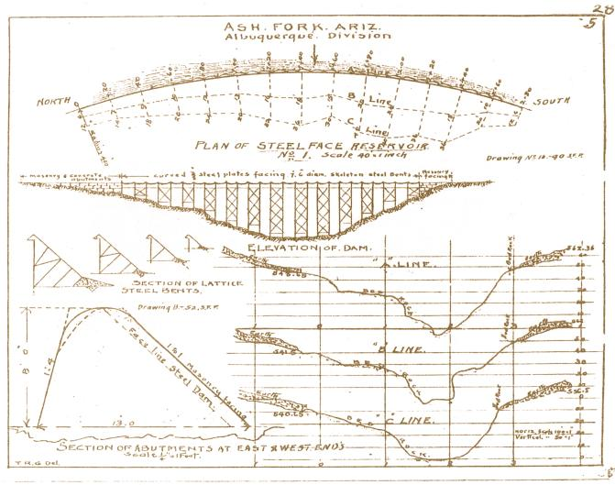
Background
Original drawings of Ashfork-Bainbridge Dam (Bureau of Reclamation)
Notes:
Give a brief overview of the presentation. Describe the major focus of the presentation and why it is important.
Introduce each of the major topics.
To provide a road map for the audience, you can repeat this Overview slide throughout the presentation, highlighting the particular topic you will discuss next.

Slide 4

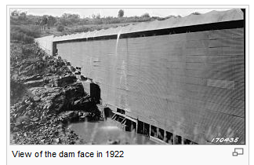
Designed by Francis H. Bainbridge and built in 1898 by the Atchison, Topeka, and Santa Fe Railway Co.
First large steel dam in the United States
46 feet high, 300 feet long and has the elevation of 5,402 feet.
It was designed as a cantilever truss with anchorage at the upstream toe.
26 square miles drainage area and a gross capacity of 400 acre-feet

Slide 5
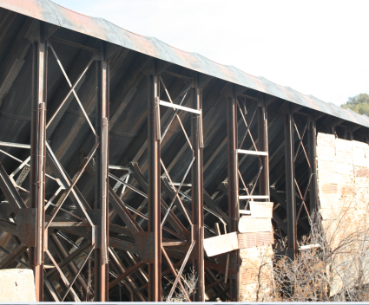
Purpose
The goal of the project is to evaluate the structure health of the Ashfork-Bainbridge Steel Dam in order to classify the current hazard potential of the dam.
Notes:
Give a brief overview of the presentation. Describe the major focus of the presentation and why it is important.
Introduce each of the major topics.
To provide a road map for the audience, you can repeat this Overview slide throughout the presentation, highlighting the particular topic you will discuss next.

Slide 6

Stakeholders
The National Forest Service
Community of Ash Fork, Arizona and occupants of Monte Carlo Truck Service.
Arizona Department of Transportation
Notes:
Add slides to each topic section as necessary, including slides with tables, graphs, and images.
See next section for sample table, graph, image, and video layouts.

Slide 7
Existing Conditions
1
2
No maintenance has been performed on the dam in recent years.
3
Recommendations made by previous analyses may be outdated
Studies completed as recent as 2009, by Technical Service Center, rated the dam as low hazard.
Notes:
This is another option for an Overview slide.

Slide 8
Service Details
Task 1- Research
Task 2- Site Visit
Task 3- Evaluation Methods
Task 4- Technical Evaluation
Task 5- Reevaluation Of Hazard Potential
Task 6- Report Findings
Notes:
Keep it brief. Make your text as brief as possible to maintain a larger font size.

Slide 9
Task 1 - Research
Existing materials provided by National Forest Service:
original design drawings
maintenance records
emergency action plans
and engineering studies

Slide 10
Task 2 - Site visit
All existing concerns previously noted will be located and confirmed.
Any issues will be documented with pictures and a detailed description.
major rust locations and reservoir water levels will be documented and recorded.
Check for signs of scour and seepage.
A detailed as-built sketch will be created.

Slide 11
Task 3 – Evaluation Method
Reference Codes:
Arizona Dam Safety
U.S Army Corps of Engineering
These evaluation guidelines will provide the design team with a proper methodology for evaluating the dam.

Slide 12
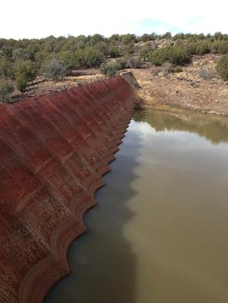
Task 4 – Technical Evaluation
Hydraulic Analysis
Overtopping
100- year flood
Normal loading

Slide 13
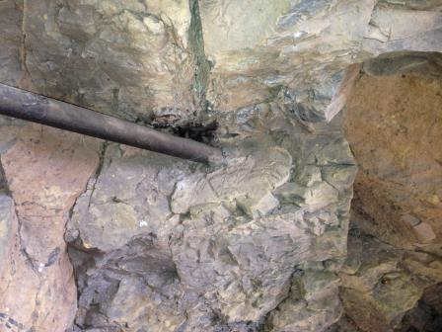
Task 4 – Technical Evaluation
2. Geotechnical Analysis
Bearing capacity analysis
3. Seismic Analysis
Seismic analysis will be based on evaluation guidelines

Slide 14
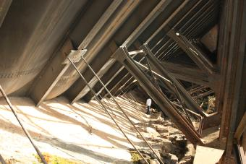
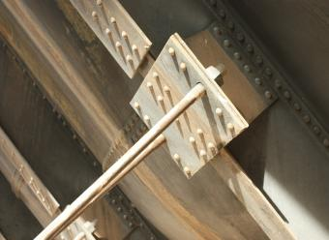
Task 4 – Technical Evaluation
4. Structural Analysis
SAP 2000 Analysis : overall dam deflection and individual member maximum loads.
Testing rusted steel and broken parts

Slide 15
Task 5 – Reevaluation of Hazard Potential
According to definition of hazard potential mode, written on the old reports, different potential hazard failure mode will be checked by calculation and model analysis.
A hazard potential rating will be developed.

Slide 16
Task 6 – Report Finding
Final report prepared for the Client:
Suggested hazard classification
Potential failure modes : cost estimation for repair/restoration of most eminent failure.
Model analysis and calculation results will be provided to support the recommendation.

Slide 17

Potential Challenges
Modeling the steel dam for analysis
Assessing scour on dam
Quoting for accurate cost
Notes:
What will the audience be able to do after this training is complete? Briefly describe each objective how the audience will benefit from this presentation.

Slide 18
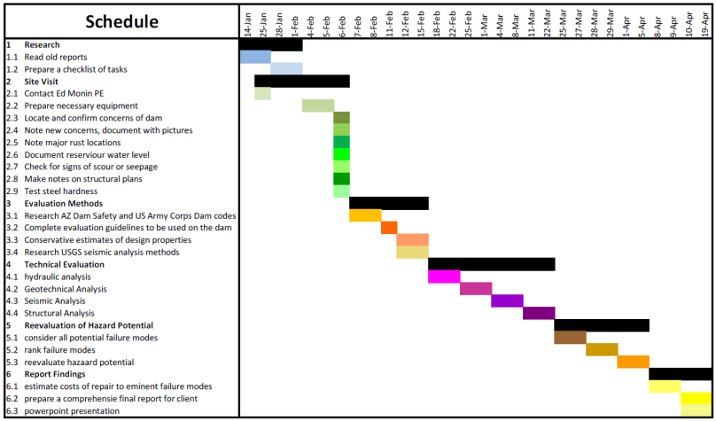
Project Duration:

Slide 19
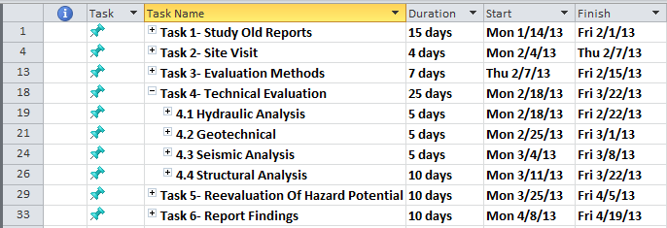
Tasks Duration Detail

Slide 20


Questions?

Slide 21
Thanks for Listening
Notes:
This template can be used as a starter file for presenting training materials in a group setting.
Sections
Right-click on a slide to add sections. Sections can help to organize your slides or facilitate collaboration between multiple authors.
Notes
Use the Notes section for delivery notes or to provide additional details for the audience. View these notes in Presentation View during your presentation.
Keep in mind the font size (important for accessibility, visibility, videotaping, and online production)
Coordinated colors
Pay particular attention to the graphs, charts, and text boxes.
Consider that attendees will print in black and white or grayscale. Run a test print to make sure your colors work when printed in pure black and white and grayscale.
Graphics, tables, and graphs
Keep it simple: If possible, use consistent, non-distracting styles and colors.
Label all graphs and tables.

